Slide 1
r/place 2023 analysis
Prit Shah
Viswadatta Chinta
Nirbhay Singh Naruka
Pranav Upadhyaya

Slide 2
Data Preprocessing
Libraries Used :
Dask - Open source Python Library
Parquet - Open source Hadoop ecosystem for columnar-storage file
Language Used :
Python
Software :
Jupyter
Extra Library:
TQDM - for smart progress meter
Notes:
TQDM- is a popular Python library that provides a simple and convenient way to add progress bars to loops and iterable objects

Slide 3
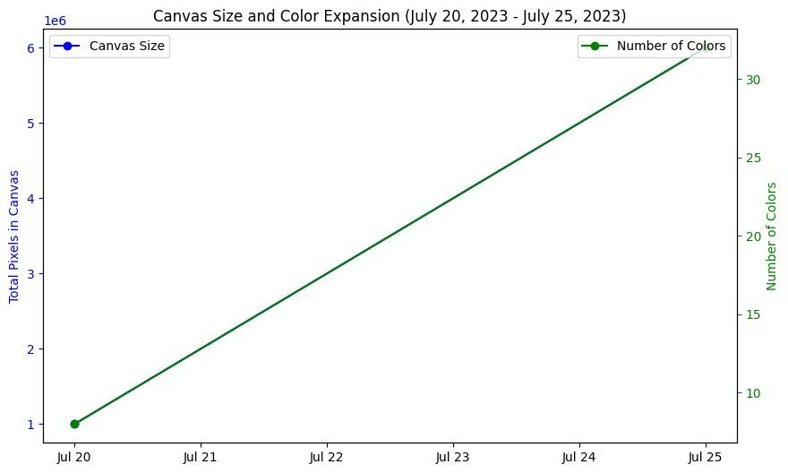
Event changes over time
Notes:
from july 20 to july 25, number of colors went from 0 to 32 and total pixels in canvas from 0 to 6 million

Slide 4
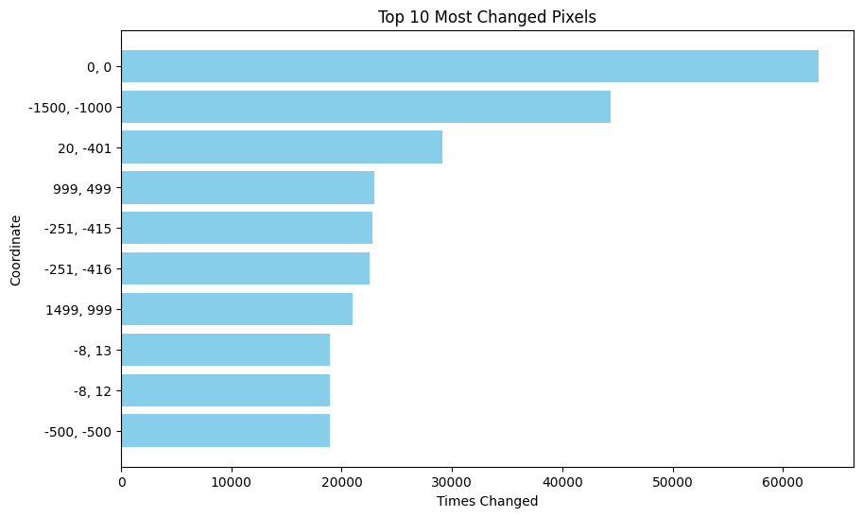
Engagement Metrics
Pixels placed once and not changed: 9,964
Total changes: 134,583,993
Total pixels: 531,988
Unique users: 8.5 million
Notes:
Note the total pixel count of 134,583,993 as an indicator of high engagement and activity in the project.
Highlight the 29,251 untouched pixels, which represent a small yet significant portion of the canvas that remained unchanged, possibly indicating areas of consensus or less interest.
Point out the 9,964 pixels placed once and unchanged, showing instances where individual contributions were preserved in the final artwork.

Slide 5
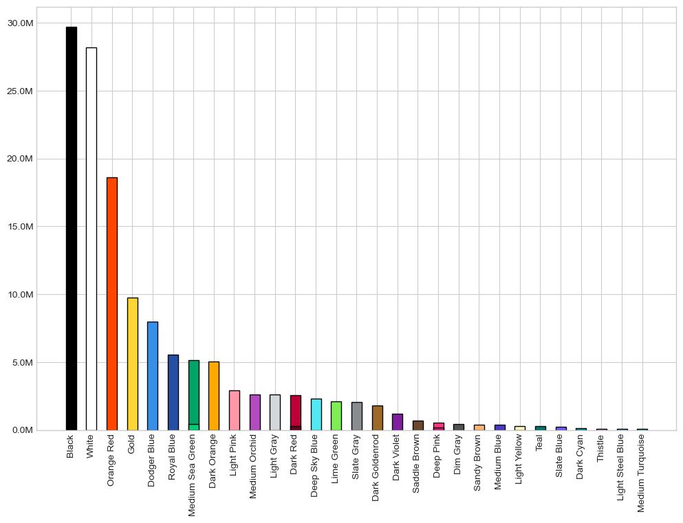
Color Statistics
Notes:
Most popular color
Black - #000000 - 30 MILLION
White - #FFFFFF 27.5 m
Orange - #FF4500 - 1.9 m
Least popular
Thistle- #E5ABFF
Light Steel Blue - #943BFF
Medium Turquoise - #00CCC0

Slide 6
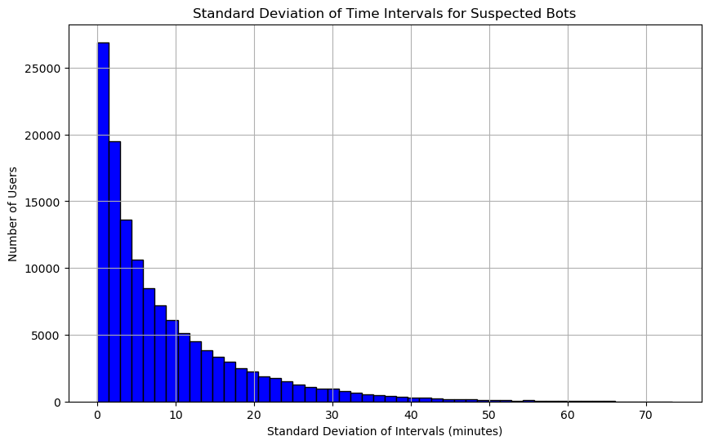
Bot users
Notes:
- The histogram represents the distribution of standard deviations of time intervals between activities for suspected bot accounts. The x-axis shows the standard deviation of intervals in minutes, while the y-axis represents the number of bot users.
- The majority of bot users have a low standard deviation, indicating that their actions occur at regular, predictable intervals. There is a rapid decline in the number of bots as the standard deviation increases, which suggests that very few bots have a high variability in the timing of their actions.

Slide 7
Identifying bots
Wait Time Between Pixel Changes
Analyzed time intervals using timestamp.diff() for each user's pixel changes.
Identified user activity patterns and frequency of placements.
Consistent intervals (low std_interval) suggest automated (bot) behavior.
User Pixel Placement Range
Pixel counts per user were calculated.
Users with over 450 placements were flagged as potential bots.
The threshold of 450 is based on an estimated 12-hour continuous engagement within a 5-day timeframe, assuming users place pixels every 5 to 20 minutes.
Bot Identification Criteria
Used high pixel counts and consistent time intervals (time_diff()) for bot detection.
Applied thresholds and patterns (e.g., low std_interval_minutes) to identify bots.
Combined quantitative thresholds and behavioral patterns for effective bot identification.
Bot count identified
Total suspected bots based on the analysis - 8603
Notes:
1. Wait Time Between Pixel Changes: "In the r/place project, users experienced a wait time of 5 to 20 minutes between placing each pixel, a measure designed to ensure equitable participation and maintain the integrity of the collaborative artwork."
2. User Pixel Placement Range: "Over a period of five days, users typically placed between 180 and 720 pixels, reflecting a wide range of engagement levels and highlighting diverse participation patterns within the project."
3. Bot Identification Criteria: "Any user activity exceeding 450 pixel placements within the specified period was flagged as potential bot behavior, a threshold set to distinguish automated inputs from genuine user interactions in the artwork's development."

Slide 8
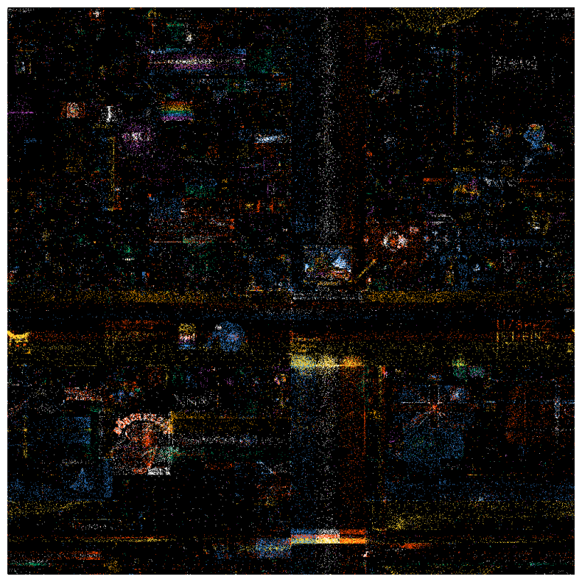
Artwork Impacted by Suspected Bots
Notes:
Analyze the potential impact of bots on the artwork, such as creating large monochromatic areas or contributing to rapid changes in the canvases appearance.

Slide 9
Bot Analysis
Some r/place participants displayed bot-like tendencies, characterized by predictable and rapid actions. This behavior was identified through patterns of high-frequency and low-variability in their activities.
These bot-like users had a significant influence on the final artwork, affecting some areas more prominently than others, potentially altering the intended collaborative nature of the project.
Notes:
User Behavior Analysis
Artwork Impact

Slide 10
Thank You
Questions?

